Slide 1
Multilevel queue scheduling
Another class of scheduling algorithms has been created for situations in which processes are easily classified into different groups.
For example, A common division is made between foreground(or interactive) processes and background (or batch) processes.
These two types of processes have different response-time requirements, and so might have different scheduling needs.
In addition, foreground processes may have priority over background processes.
A multi-level queue scheduling algorithm partitions the ready queue into several separate queues.
The processes are permanently assigned to one queue, generally based on some property of the process, such as memory size, process priority, or process type.
Each queue has its own scheduling algorithm.

Slide 2
For example, separate queues might be used for foreground and background processes. The foreground queue might be scheduled by the Round Robin algorithm, while the background queue is scheduled by an FCFS algorithm.
In addition, there must be scheduling among the queues, which is commonly implemented as fixed-priority preemptive scheduling. For example, The foreground queue may have absolute priority over the background queue.
Let us consider an example of a multilevel queue-scheduling algorithm with five queues:
System Processes
Interactive Processes
Interactive Editing Processes
Batch Processes
Student Processes

Slide 3
Each queue has absolute priority over lower-priority queues.
No process in the batch queue, for example, could run unless the queues for system processes, interactive processes, and interactive editing processes were all empty.
If an interactive editing process entered the ready queue while a batch process was running, the batch process will be preempted.

Slide 4
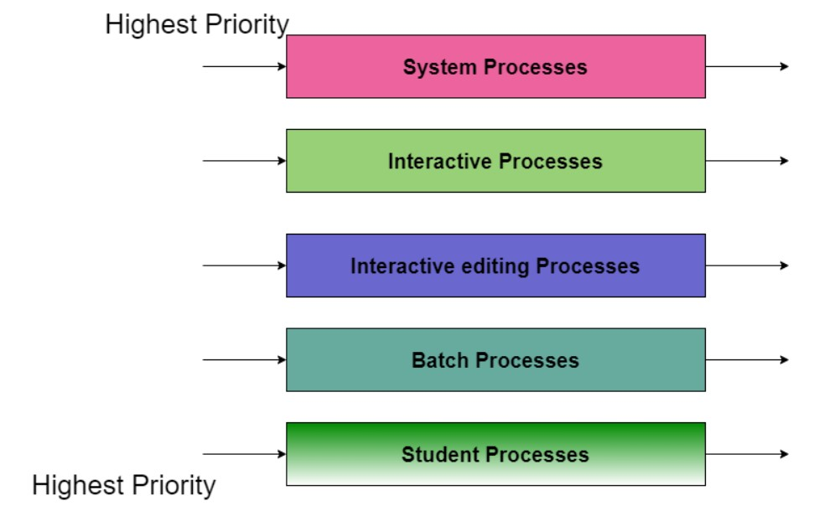

Lower Priority
Fig. Multilevel Queue Scheduling

Slide 5
In this case, if there are no processes on the higher priority queue only then the processes on the low priority queues will run.
For Example: Once processes on the system queue, the Interactive queue, and Interactive editing queue become empty, only then the processes on the batch queue will run.
The Description of the processes in the above diagram is as follows:
System Process The Operating system itself has its own process to run and is termed as System Process.
Interactive Process The Interactive Process is a process in which there should be the same kind of interaction (basically an online game ).

Slide 6
Batch Processes: Batch processing is basically a technique in the Operating system that collects the programs and data together in the form of the batch before the processing starts.
Student Process: The system process always gets the highest priority while the student processes always get the lowest priority.

Slide 7
Advantages of Multilevel Queue Scheduling
With the help of this scheduling we can apply various kind of scheduling for different kind of processes:
For System Processes: First Come First Serve(FCFS) Scheduling.
For Interactive Processes: Shortest Job First (SJF) Scheduling.
For Batch Processes: Round Robin(RR) Scheduling
For Student Processes: Priority Scheduling

Slide 8
Disadvantages of Multilevel Queue Scheduling
The main disadvantage of Multilevel Queue Scheduling is the problem of starvation for lower-level processes.
Starvation:
Due to starvation lower-level processes either never execute or have to wait for a long amount of time because of lower priority or higher priority process taking a large amount of time.

Slide 9
Multilevel Feedback Queue Scheduling
In a multilevel queue-scheduling algorithm, processes are permanently assigned to a queue on entry to the system.
Processes do not move between queues. This setup has the advantage of low scheduling overhead, but the disadvantage of being inflexible.
Multilevel feedback queue scheduling, however, allows a process to move between queues.
The idea is to separate processes with different CPU-burst characteristics.
If a process uses too much CPU time, it will be moved to a lower-priority queue.
Similarly, a process that waits too long in a lower-priority queue may be moved to a higher-priority queue.
This form of aging prevents starvation.

Slide 10
In general, a multilevel feedback queue scheduler is defined by the following parameters:
The number of queues.
The scheduling algorithm for each queue.
The method used to determine when to upgrade a process to a higher-priority queue.
The method used to determine when to demote a process to a lower-priority queue.
The method used to determine which queue a process will enter when that process needs service.
The definition of a multilevel feedback queue scheduler makes it the most general CPU-scheduling algorithm.
It can be configured to match a specific system under design.
Unfortunately, it also requires some means of selecting values for all the parameters to define the best scheduler.
Although a multilevel feedback queue is the most general scheme, it is also the most complex.

Slide 11
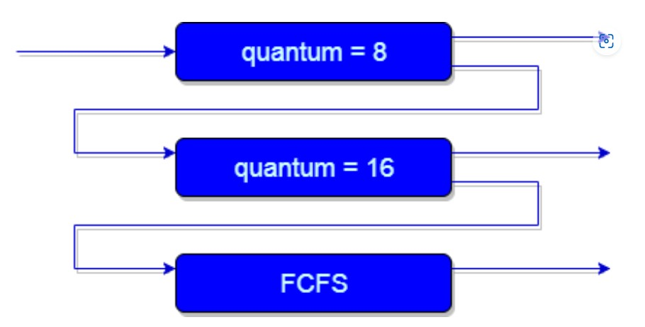
An example of a multilevel feedback queue can be seen in the above figure.

Slide 12
Explanation:
First of all, Suppose that queues 1 and 2 follow round robin with time quantum 8 and 16 respectively and queue 3 follows FCFS. One of the implementations of Multilevel Feedback Queue Scheduling is as follows:
If any process starts executing then firstly it enters queue 1.
In queue 1, the process executes for 8 unit and if it completes in these 8 units or it gives CPU for I/O operation in these 8 units unit than the priority of this process does not change, and if for some reasons it again comes in the ready queue than it again starts its execution in the Queue 1.
If a process that is in queue 1 does not complete in 8 units then its priority gets reduced and it gets shifted to queue 2.

Slide 13
4.Above points 2 and 3 are also true for processes in queue 2 but the time quantum is 16 units. Generally, if any process does not complete in a given time quantum then it gets shifted to the lower priority queue.
5.After that in the last queue, all processes are scheduled in an FCFS manner.
6.It is important to note that a process that is in a lower priority queue can only execute only when the higher priority queues are empty.
7.Any running process in the lower priority queue can be interrupted by a process arriving in the higher priority queue.
Also, the above implementation may differ for the example in which the last queue will follow Round-robin Scheduling.

Slide 14
In the above Implementation, there is a problem and that is; Any process that is in the lower priority queue has to suffer starvation due to some short processes that are taking all the CPU time.
And the solution to this problem is : There is a solution that is to boost the priority of all the process after regular intervals then place all the processes in the highest priority queue.

Slide 15
The need for Multilevel Feedback Queue Scheduling(MFQS)
Following are some points to understand the need for such complex scheduling:
This scheduling is more flexible than Multilevel queue scheduling.
This algorithm helps in reducing the response time.
In order to optimize the turnaround time, the SJF algorithm is needed which basically requires the running time of processes in order to schedule them. As we know that the running time of processes is not known in advance. Also, this scheduling mainly runs a process for a time quantum and after that, it can change the priority of the process if the process is long. Thus this scheduling algorithm mainly learns from the past behavior of the processes and then it can predict the future behavior of the processes. In this way, MFQS tries to run a shorter process first which in return leads to optimize the turnaround time.

Slide 16
Advantages of MFQS
This is a flexible Scheduling Algorithm
This scheduling algorithm allows different processes to move between different queues.
In this algorithm, A process that waits too long in a lower priority queue may be moved to a higher priority queue which helps in preventing starvation.

Slide 17
Disadvantages of MFQS
This algorithm is too complex.
As processes are moving around different queues which leads to the production of more CPU overheads.
In order to select the best scheduler this algorithm requires some other means to select the values.

